Slide 1
Traffic Management system
BY :
Oleksandr Cherednychenko
Esmond A. Davison
Farhad Rahimli
Kumar Awijeet
Jacek Krupski
Notes:
Good afternoon ladies and gentleman. Today I will be presenting to you briefly about our Traffic Management System. Well to summarize this project in one word the word would be “gigantic”.

Slide 2
introduction
Micro modeling approach for the system
Java
Development tools
“INTELLIJ”
“GITHUB”
Notes:
That being said we as a team have still thought to take micro modeling, now I am sure half of you would be asleep by now and remaining half don’t know what is micro modeling. In layman's terms it’s a model where we consider each car as an object so, no generalization based on anything. To achieve our goal we are planning to use Java language. Now first of all as I said this project is gigantic so the basic question is how can we really achieve it without compromising the goals and paths that we have decided to take. Well the first steps which we took as a team was to decide on these two tools. The INTELLIJ and GITHUB, both of them are very versatile tools and very easy to understand, and work with. Now all this tools aren’t of any use without the team members being able to use them efficiently and possitively, so with that said lets move on to the next slide and see how this is achieved.

Slide 3
Team organization
Equal participation
Dispute resolution process
Weekly meetings face to face
Kanban (“Trello”, “Hip chat”)
Notes:
So here we have the team organization. Now the very first point that we had to have was equal participation, and this is easier said than done, because we all come from different backgrounds and have different experiences, thus it’s practically not possible to make 100% sure that we get equal participation from everyone. So here is what we decided to do, lets say one team member isn’t as good as the others at coding, but they are good at other things such as documenting or management. So this member will be given more work from those two aspects. This doesn't mean he won’t be participating in their weak aspect of the project, just means that what loss we have in one section, will be made up for the extra work in another section. Now we also knew there will be disputes, so we made a process to resolve them. Simple and easy, talk it out, if not debate it out, still no go for a group poll, and accept the decision without any ill feelings. Obviously the feelings part is just a suggestion, nothing else. Till now the progress on the project has been good, which my team member will show to you in sometime, but let’s get on with the why. Well first reason is our coordination, we have been having weekly meetings without any coordination issues. The members are very well aware of the meetings well in advance and rarely we have had absentees. We also have made sure we have a second day, just incase we can’t meet on the planed day for some reason or we have extra work which needs attention. To make this really work out we use Trello and Hip Chat. Trello is a tool that helps us keep a track of the work that is done and needs to be done. Hip Chat is for chatting with friends, well you must be wondering why not use what’s app or any other messaging app. The main reason is with Hip Chat we get updates about everything, about what files have been saved, by whom when. All this inside the chatroom. This makes it very easy for one to manage things, and talk about things without having to explain a lot. With that said I think I have explained a lot now and it’s time for someone else to come and explain the remaining aspects of the project, so thank you very much for trying to listen to me, have a nice day!

Slide 4
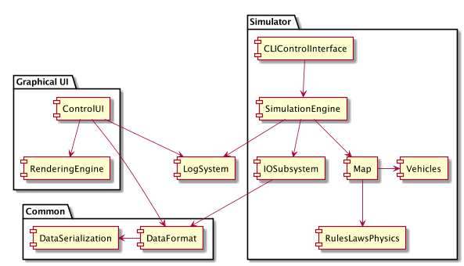

Slide 5
